Slide 1
DNA Nanotechnology
A Future Perspective
Team Members: Group 12
Kavita (19NA10011)
Shobhit Mahajan (19AE30018)
Manvi Godika (19BT30014)
Vinod (19AG36023)
Charvi Jain (19CH30032)
Shyamal Raj (19CE10064)

Slide 2
Content
DNA wires, capacitors and other devices
Cancer Nanotechnology
Dendrimers, and contraception
Mathematical problems
Introduction
Conclusion
DNA Biological Applications
Drug Delivery and biosensors
DNA Computing
Physical Applications
Correction of sequence mismatch

Slide 3
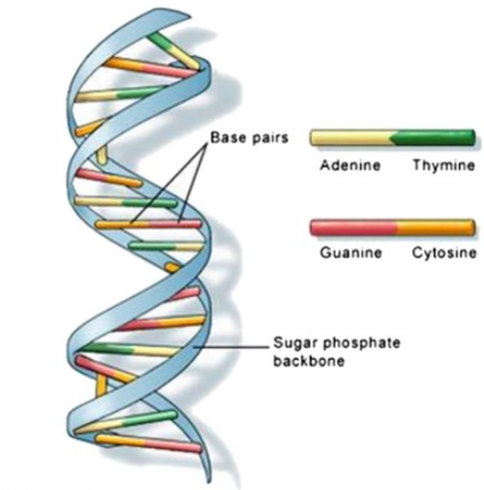
Introduction
It primarily consists of nitrogenous base pairs of adenine with thymine (A-T) and guanine with cytosine (G-C)
Nucleic acids encode the genomes of all living things on earth. DNA has become a key biological molecule in the study of genetics, medicine, and biotechnology.
Precision programmability & specificity
easily assembled into predictable nanoscale structures by hydrogen bonding
DNA is made up of two kinds of nitrogenous bases, purines (adenine and guanine) and pyrimidines (thymine and cytosine). Purine bases bind only to their respective pyrimidine bases, i.e., adenine always pairs with thymine, while guanine binds to cytosine.
DNA has also become a preferred material for nanotechnologists because of its unique properties of structural stability, programmability of sequences, and predictable self-assembly.
excellent smart material for designing and fabricating nanostructures
Double helical structure of DNA proposed by Watson and Crick in 1953
composed of two polynucleotide chains that coil around each other to form a double helix
Notes:
PRECISION PROGRAMMABILITY

Slide 4
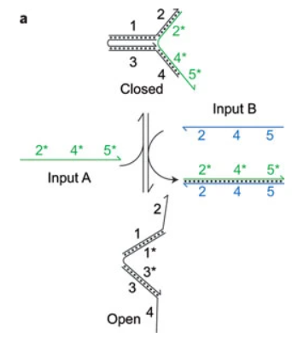
SOME HISTORY?
In 1990s, Seeman and colleagues first described a process by which DNA could be hybridized in more than one way to create self-assembling nanostructures. They created tiles made up of DNA with sticky ends which were allowed to hybridize to form a cube-like structure.
Yurke's DNA tweezers showed that DNA hybridization and strand displacement can be used to engineer molecular-scale changes in structure.
Input A binds to distal domains 2 and 4 of the tweezers, causing the tweezers to adopt a closed configuration. Input B displaces the tweezers in binding to input A, releasing the DNA tweezers and allowing them to relax into an open configuration.
Why this reaction?
Each reaction step is driven by the formation of additional base pairs and each full cycle leads to the production of an inert double-stranded by-product.
This method made it possible to form a variety of nanostructures based on differences in sequence, rather than being dependent on the influence of changes in the environment surrounding the DNA (pH, salt, and temperature)
Hing
Double helix DNA sequence
short DNA sequence
Single stranded DNA sequence
A) Pushing the 2 arms apart
B) Setting them free
Notes:
How did scientist got this idea of producing nanostructures from DNA??*****
They achieved this by exploiting two double helical arms of DNA connected by another short DNA sequence acting as a ‘hinge’. This ‘hinge’ repeatedly cycled the two strands into an opened and closed state by consecutive addition of two single-stranded DNA molecules.
Addition of a first input strand pushed the two arms of the nanoactuator apart; addition of a second input strand set them free : have to say
a hybridization step followed by strand displacement to reverse the effect of the initial hybridization

Slide 5
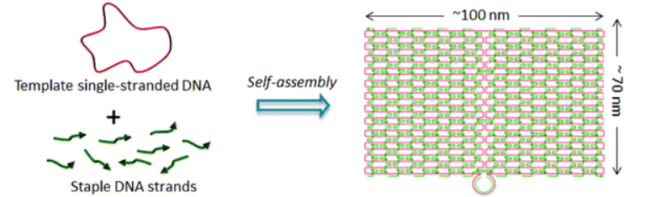
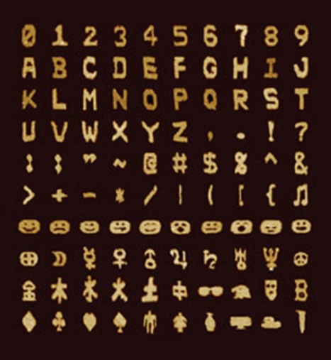
Structural DNA Nanotechnology
DNAs have been manipulated to construct branched junction structures in one, two, and even three dimensions with distinct geometries. The majority of researchers have used a ‘bottom up’ approach of DNA self-assembly to construct dynamic structures.
In 2006, the emergence of DNA origami (a process of DNA self folding) transformed the landscape of structural DNA nanotechnology. The DNA origami method uses a number of short single-stranded DNA (ssDNA) oligonucleotides to direct the folding path of a long ssDNA “scaffold” strand
Rothemund used genomic ssDNA from the M13 phage as the scaffold strand (7249 nucleotides) and designed a set of short “staple” strands to selectively bind to distant regions of the scaffold and fold it into a predesigned shape.
Utility of DNA Origami?
This has led to the development of several macroscopic structures with nanometer-size features. It has also been used to produce various kinds of reprogrammable functionalized devices and sensors, some of which will be discussed in this seminar
Complex shapes designed using a DNA molecular canvas
3D DNA origami nanostructures have also been used for modulating and studying enzymatic behavior, such as using a ‘‘nanocage’’ to encapsulate multiple enzymes to improve reaction efficiency
Notes:
DNA-modifying enzymes can also be used to generate and manipulate DNA nanostructures.

Slide 6
DNA Biological Applications

Slide 7
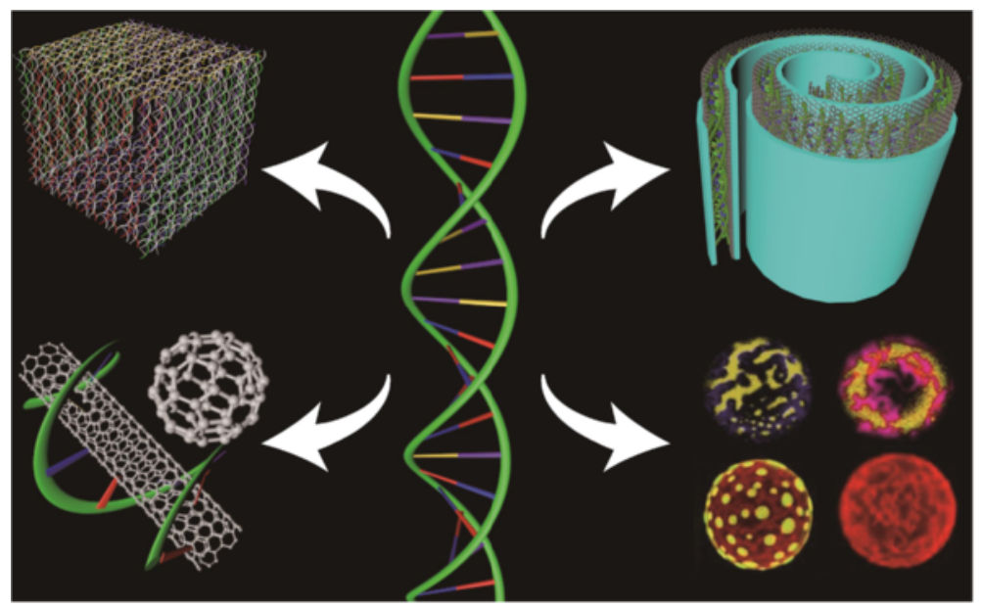
The properties of nanomaterials such as polymers, semiconductors, and metals present diverse advantages for various In vivo applications
Nanobiotechnology provides a new perspective in both medicine and pharmacology leading to the development of a new field called nanomedicine; Pharmaceutical companies are expanding their research to the application of nanotechnology in vital areas of medicine such as drug delivery and disease therapy
But, we’ve got Challenges!
Nature has developed an intelligent and complex material at the nanoscale through millions of years of evolution
And, Advances in structural DNA nanotechnology would create important progress in the nanotechnology field…
Structural DNA nanotechnology has applications in modern nanodevice fabrication

Slide 8
Cancer and Nanotechnology

Slide 9
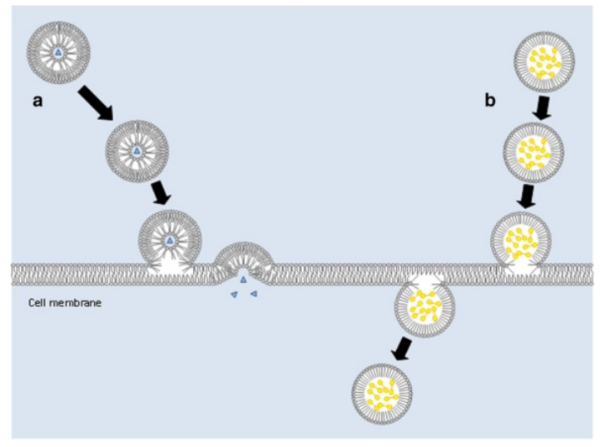
The Problem: More than 10 million people around the world develop some form of Cancer in a single year
Cells begin to function and divide abnormally
Most cancer therapies require an optimum concentration of chemotherapeutic agents at the tumor site to destroy cancerous cells while diminishing injury to normal cells
The Possible Solution: Nanotechnology prevent healthy cell loss as an alternative to chemotherapy
Development of technologies such as ligand-targeted delivery of therapeutic drugs and nanocarriers ranging in sizes from 10 to 100 nm
Nanocarriers: liposomes or albumin-based nanoparticle
Drug deliveries by (a) liposomes and (b) emulsions across a cell membrane

Slide 10
Liposome-based nanoparticles carry miniscule amounts of chemotherapeutic agents to affected cancer sites; The lipid compositions of liposomes allow them to easily diffuse across cell membranes to deliver therapeutic product to cells
Insufficiency of nanostructures for effective treatment of cancer cells has led to the development of influential ‘nano-systems’,
therapeutic/diagnostic themselves, and thus theoretically can be designed to carry a large therapeutic cargo deliverable to the tumor site
more than one targeting ligand can be attached to these nanosystems, providing high affinity and specificity for target cells
house more than one type of therapeutic drug, thereby providing multivalent drug therapy
designed from biological materials such as DNA and RNA are ‘programmed’ to be able to evade drug-resistance mechanisms
These properties let nanosystems to deliver high concentrations of drugs to cancer cells while curtailing damage to surrounding healthy cells

Slide 11
Drug delivery and biosensors

Slide 12
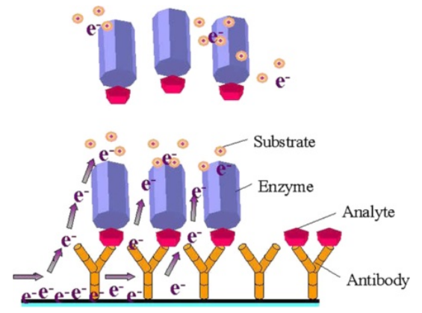
What exactly are Biosensors?
Biosensors : devices that are capable of picking up biological signals and converting them into electrical outputs that can be analyzed for identification
efficient because of high surface area to volume ratio
adjustable electronic, magnetic, optical, and biological properties
engineered to have diverse chemical compositions, shapes, sizes, and hollow or solid structures
Incorporated into new generations of drug delivery vehicles, and diagnostic devices
biosensor fabrication setup designed to mediate various molecular interactions and to identify minuscule molecular changes with high sensitivity.

Slide 13
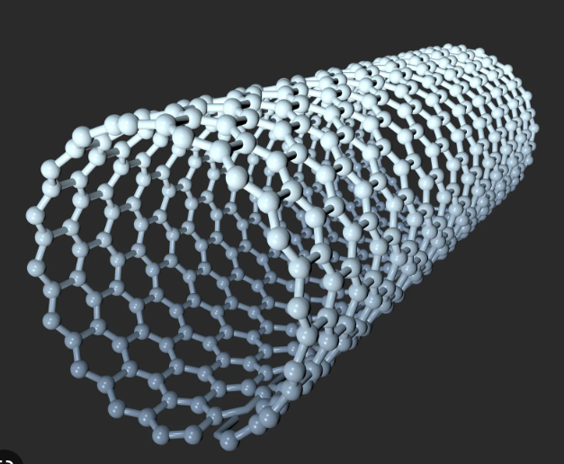
Porous inorganic particles loaded with an assortment of drugs in organic nanomicelles target specific cells and tissues
Carbon nanotubules are influential drug delivery vehicles for cancer treatment; both carrying and protection of drugs from external influences
Highly organized DNA lattices used to detect biological activity of various molecules
DNA thin films : prepared by dropping DNA samples into a polymer optical fiber responding quickly to the specific biomolecules in the atmosphere;
Coating optical fibers with DNA nanostructures could be used for detecting atmospheric bio-aerosols with high sensitivity and specificity
Carbon Nanotube

Slide 14
Nanotechnology-Dendrimers & Contraception
Synthetic polymers such as dendriworms are made up of dendrimer units of magnetic nanoworms and are being used for intercellular delivery of siRNA.
siRNA (small interfering RNA) are a type of RNA molecule that can inhibit the expression of specific genes by regulating certain gene expression by sequence-specific inhibition of mRNA translation.
Dendrimers are used as carriers for siRNAs. The magnetic property of these nanoworms allows them to be directed towards specific location and fluorescence allows detection.
siRNA delivery vehicles such as lipid and polymer nanoparticle-based dendrimers have proven effective in improving the stability, bioavailability, and target specificity.
Bionanotechnology has also been applied in the field of contraception.
In recent days, various nanomaterials drugs are being researched for new contraception techniques like drug for inhibition of FSH.
Bionanotechnology aims to develop drugs that may be effective in targeting the fallopian tubes.
Anti-implantation drugs can be employed in the uterus to foil pregnancy without influencing other organs.

Slide 15
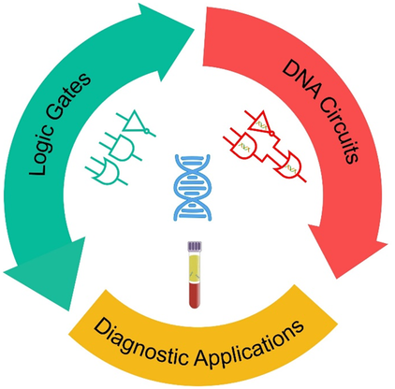
DNA Computing
DNA computing is a type of computing that uses DNA molecules to store and process information.
The incredible storage capacity of DNA is used to solve complex computational problems much faster and easier.
Sticker DNA model applies to random access memory and requires no enzymes or strand extension. This method, thus, has the capability of becoming the universal method for DNA computation.
One of the main applications of DNA computing is in DNA-based sensors, where DNA strands are used to detect the presence of specific molecules in a solution.
DNA computing can also be used to create logic gates, which are fundamental components of digital circuits used in electronic computing.

Slide 16
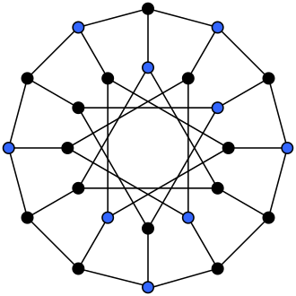
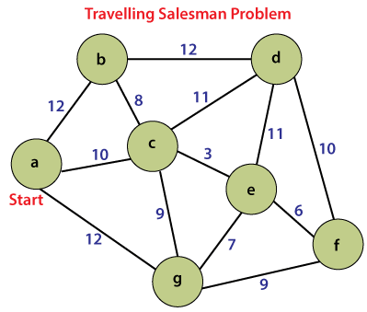
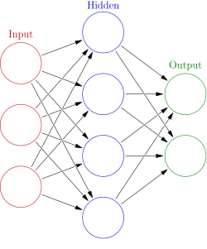
Mathematical Problems
Adelman’s theory on travel salesman problem also known as Hamiltonian path problem in 1994
Development of Artificial Neural Network by Qian Group
Using sticker based DNA to solve Independent set problem
Square Root calculation using seesaw gates - proposed by Qian and Winfree in 2011
Notes:
With the extraordinary properties of DNA molecules researchers entered into DNA computing which made possible to solve several mathematical and biological problems.

Slide 17
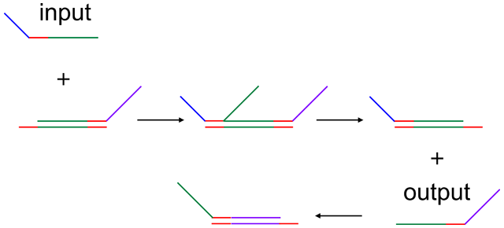
Square root calculation
In 2011, Qian and Winfree were able to calculate square roots using ‘seesaw’ logic gates. The idea behind these gates is that a single stretch of DNA can pair up with various molecules, thus allowing competition for binding sites.
Once a molecule is attached, it can be replaced instantly to allow other molecules to fasten themselves to the resident sequence, which itself can be displaced again.
This system allows ‘gates’ to be loaded with several input molecules and generates logical output molecules as a result. The various DNA strands can come to represent numbers, of which output can yield the square root result as answers

Slide 18
DNA Computers
DNA Computing
Conventional Computers
Storage Media
Nucleic Acids
Semiconductors
Memory Capacity
Ultra High
High
Operators
Bio-chemical Operations
Logical ( and, or, not)
Operation
Simultaneous (Parallel)
Bitwise (Sequential)
Speed of each operations
Slow
Fast
Process
Stochastic
Deterministic

Slide 19
Limitation of the proposed theory
Computational Time
There are certainly caveats. Calculating the square root of numbers is an impressive achievement for DNA, but the process of extracting that information takes hours. In addition, there's the reuse problem. "The DNA circuits are currently use-once circuits—the circuit components are consumed when the computation is done," Qian says. This presents a serious limitation—imagine having to rebuild your computer every time you ran a program.
Reusability problem

Slide 20
Physical Applications
Defining the term Nanoelectronics
Nanotechnology for the use and development of electrical components and circuits
CMOS technology, its usage and its limitations
Complementary symmetry metal oxide semiconductor (CMOS) technology has been vital in analogue circuits.
DNA offers a solution to this problem
CMOS is being replaced as the demand of further miniaturization and processing speed increase.

Slide 21
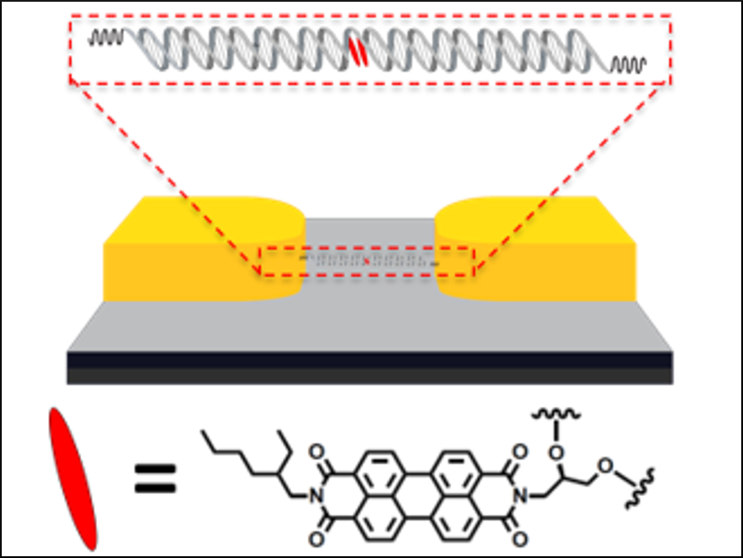
DNA wires, transistors, capacitors and other devices
Notes:
Enhancement of the Electrical Properties of DNA Molecular Wires through Incorporation of Perylenediimide DNA Base Surrogates

Slide 22
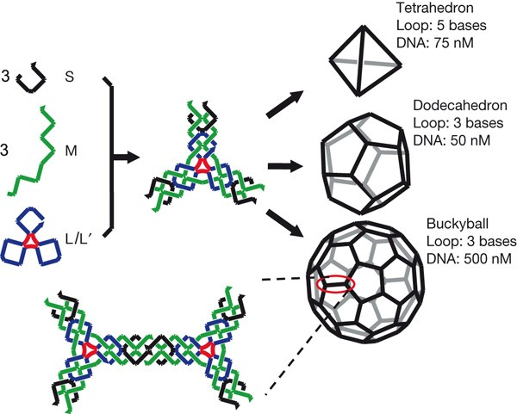
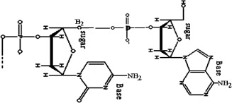
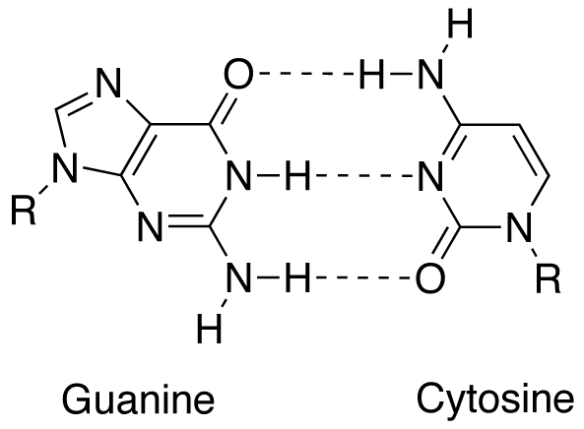
DNA Self Assembly
Common terminologies
Single Strand of DNA
Basically a single strand of DNA built up by units comprising of a sugar and a base. The kernels are connected by different Phosphorus bridges or else what we call the P-Bonds, whereas the complementary bases in different strands are connected by hydrogen bonds or H-Bonds
DNA self-assembly is essential to form any nanoscale biological device. It is the spontaneous self-ordering and reversible organization of DNA structural components into well-arranged nanostructures driven by the selective affinity

Slide 23
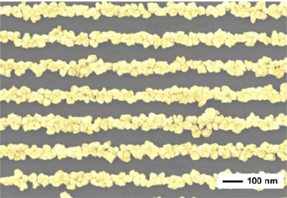
New conformation of DNA - a nanowire
1. It is right handed double helix structure
2. It was used before nanowires were invented
3. It has excellent geometric properties for self-assembly
4. It has very limited conductivity at room temperature
B-DNA
1. Invented in 1993 by addition of zinc at high pH. It is a good conductor than B-DNA
2. M-DNA duplex is a chain of metals surrounded
by an organic sheet and, hence, capable of electron
transport
M-DNA
SEM image of DNA template nanowires

Slide 24
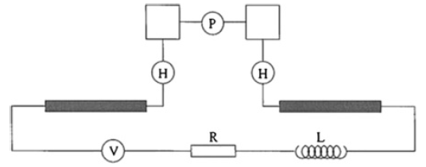
Schematic of a DNA transistor
A qubit made of one short DNA strand attached to two long strands by two H-bonds. The long strands are metal-coated and connected to an external voltage source, V, via resistance, R, and inductance, L

Slide 25
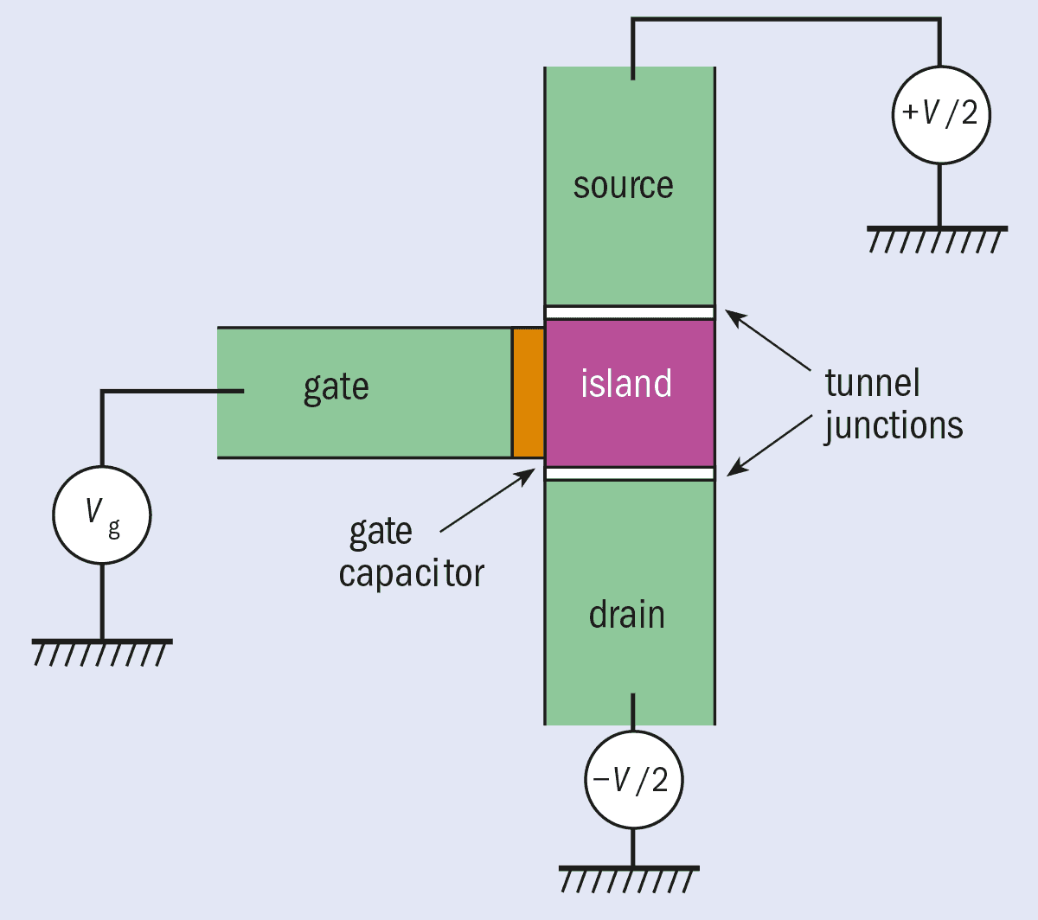
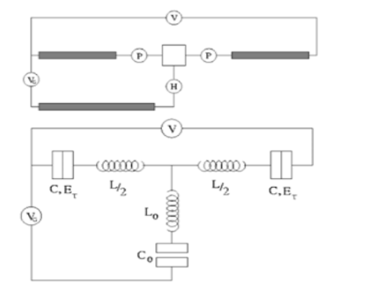
Single Electron Transistor (SET)
The SET transistor can be viewed as an electron box that has two separate junctions for the entrance and exit of single electrons. The tunneling junctions are mainly thin oxide layers in this case with a potential difference which electrons can tunnel through.
DNA based single electron transistor (SET)

Slide 26
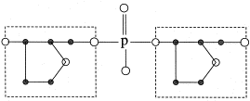
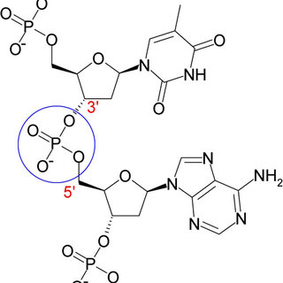
DNA based Single Electron Transistor
How the phosphate bridge acts as a tunnel?
Phosphate bridges in DNA strand can act as tunneling junctions for SET transistor.
H-bonds have capacitive properties. The proton present in the H-bond between two strands can produce a net charge density.
Coating of DNA strands with metal, thus forming a conductive wire with self assembly property.
When two oxygen atoms diagonally connected to the phosphorus atom, it is what we call as the origin of this tunnel junction. Now, two σ bonds and one π bonds are made up by the oxygen, when it shares three electrons with the phosphorous. As the lowest level is occupied by π electron, it resembles an electron in a double well potential. When an additional electron proceeds towards the well, a narrow barrier is encountered, due to the presence of an energy gap to the next level of the well and these electrons can easily tunnel through it.

Slide 27
Enhancing the transistor behaviour
Advantages of DNA transistors
Enhancing Natural Energy Gap of the DNA
Altering the tunneling rates of two junctions
DNA Transistors are very small in size. So implementing these transistors in IC would reduce the chip area and so more number of chips can be fabricated on devices like computers and sensors. Thus much faster device can be constructed
Using a longer strand of DNA having more than one grain. Longer chains of DNA tend to have more non-linear effects. As a result, more charges are formed. A large uncoated DNA molecule is, thus, used as compared to one that is entirely coated with a metal sheath.
The tunneling rates of electrons, however, are about the same as the two phosphate bonds are identical. To counter this effect, a chemical group may be attached to one of the phosphate bonds, thus altering its properties and making electron transport and transistor behavior possible

Slide 28
DNA Capacitors and other devices
Some studies have reported the formation of three-dimensional structures such as switches and motors; devices such as DNA-based capacitors are also being contemplated.
Biological polymer-based DNA hybrids have intriguing electrical characteristics such as
High dielectric constant
Dielectric breakdown behavior
Good resistivity.
These are encouraging signs for the development of DNA-based capacitors.

Slide 29
Correction of Sequence Mismatch
Overview of synthetic DNA production, including the ability to synthesize small molecules up to entire viral genomes
Limitations of current synthetic DNA production, such as high cost and significant error rates
Importance of error-free DNA synthesis for successful research
Strategies for developing error-free DNA, including physical separation and PCR-based approaches such as hairpin PCR, selective destruction methods, and self-assembly
Use of CEL I nuclease enzyme for error reduction and its benefits in reducing common insertions and deletions that may occur during DNA synthesis

Slide 30
Methods for reducing error rates in Synthetic DNA Synthesis
Introduction to strategies for reducing error rates in synthetic DNA synthesis, including spatial confinement on a silica chip, photochemistry, and directing redox reactions
Explanation of how spatial confinement on a silica chip and photochemistry can help reduce error rates by controlling the locations where reagents end up and blocking reactions at potential error sites
Discussion of how directing redox reactions only at desirable sites in the forming DNA can help reduce error rates
Examples of successful implementation of these strategies in research and their benefits in reducing error rates from 1 in 200 bases to 1 in 600 bases
Importance of continued development and improvement of synthetic DNA synthesis methods for future research applications.

Slide 31
Conclusion
DNA is a valuable engineering material in nanotechnology due to its potential for self-assembly and programmable nanostructures and its ability to provide a platform for mechanical, chemical, and physical devices.
There is a need to aggressively pursue the development of DNA-based nanotechnologies for diverse applications in medicine, computation, material sciences, and physics.
The development of sophisticated architectures for DNA-based nanostructures with viable physical, chemical, and biological applications is urgently needed.
Despite the limited forays into electronics and mathematics, DNA computation has great potential for future development and could have a comprehensive role in biological computation and data storage.
The use of DNA molecules is expected to exceed expectations far beyond the scope of current understanding and capabilities in nanotechnology.

Slide 32
References
https://www.section.io/engineering-education/dna-computing/
https://www.popularmechanics.com/science/health/a11898/the-strands-of-dna-that-can-calculate-square-roots/
https://arstechnica.com/science/2011/06/dna-logic-gates-calculate-a-square-root-using-130-different-molecules/
https://acloudguru.com/blog/engineering/what-is-dna-computing-technology#:~:text=DNA%20can%20perform%20countless%20calculations,for%20scenarios%20like%20machine%20learning.
https://www.nature.com/articles/nchem.957

Slide 33
Thank You

